Slide 1
Lecture-12
Analysis and Synthesis of Pole-Zero Speech Models

Slide 2





Speech Production Model
H(z)=G(z)V(z)R(z)
A_{v}
Impulse
Train
Generator
Glottal
Pulse
G(z)
Vocal Track
Parameters
Voiced Sound
u_{G}[n]
Vocal Track
V(z)
u_{L}[n]
Lip
Radiation
R(z)
p_{L}[n]
Unvoiced Sound
Random
Noise
Generator
A_{N}
H(z)

Slide 3
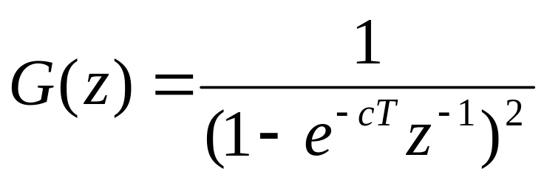
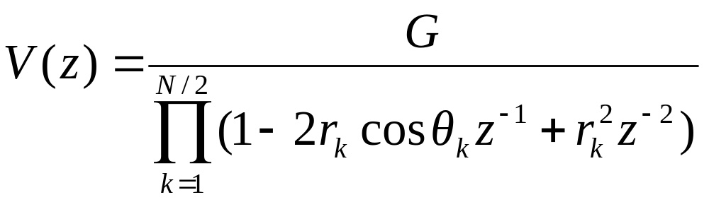
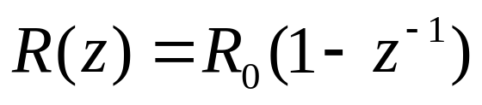
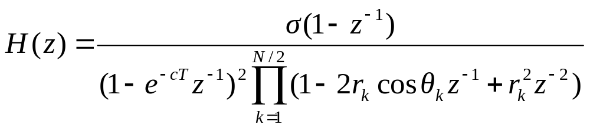
Speech Production Model
H(z)=G(z)V(z)R(z)

Slide 4
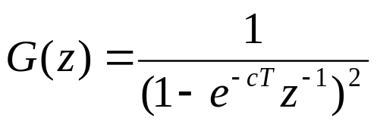

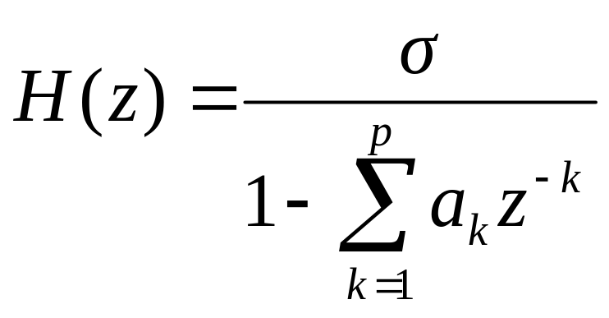
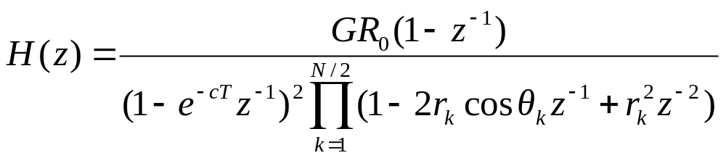
All pole modeling
H(z)=G(z)V(z)R(z)

Slide 5
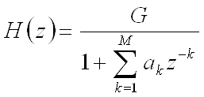
  General Speech model:
Pitch period, P
Sometimes neglected
Gain (G)
Voiced/unvoiced switch
DT
Impulse
generator
G(z)
Glottal
filter
⊗
Voiced
u(n)
Voice
volume
velocity
V
H(z)
Vocal
tract
filter
R(z) Lip
radiation
filter
s(n)
Speech
signal
Uncorrelated
noise
generator
U
Unvoiced
⊗
Gain (G)

Slide 6
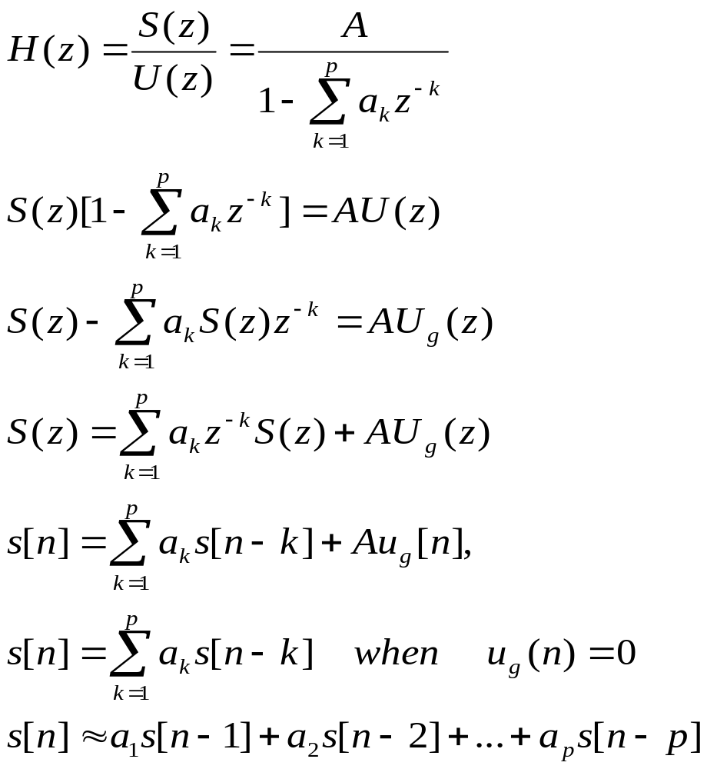
The LPC Model

Slide 7
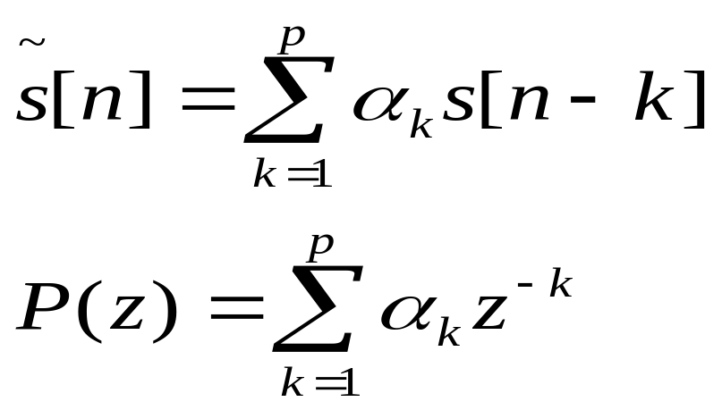
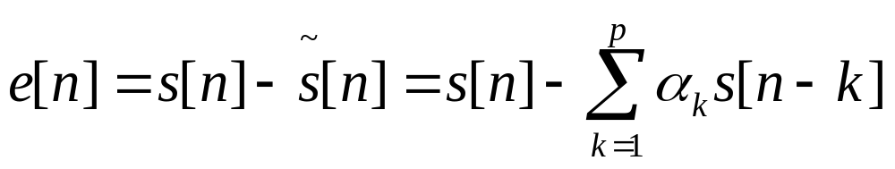
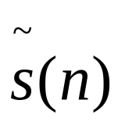
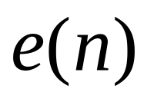
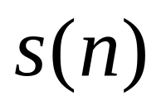


Liner predictor
FIR Filter of order P
The prediction error:
P(z)
-

Slide 8
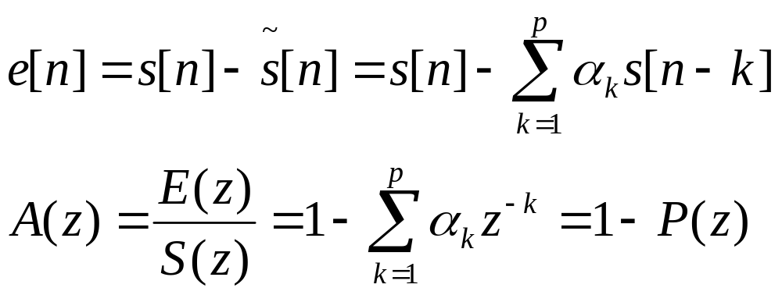
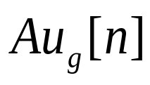

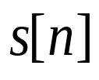
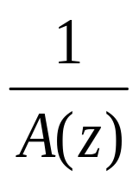
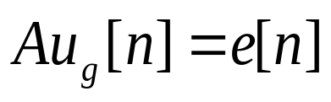

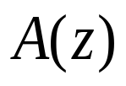
Error transfer function:

Slide 9
LP Estimation Issues
Need to determine {α_{k}} directly from speech such that they give good estimates of the time-varying spectrum
Need to estimate {α_{k}} from short segments of speech
Need to minimize mean-squared prediction error over short segments of speech
resulting {α_{k}} assumed to be the actual {a_{k}} in the speech production model
all of this can be done efficiently, reliably, and accurately for speech

Slide 10
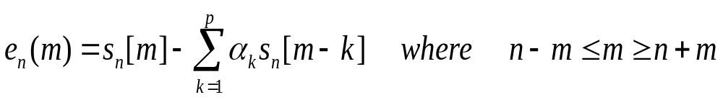
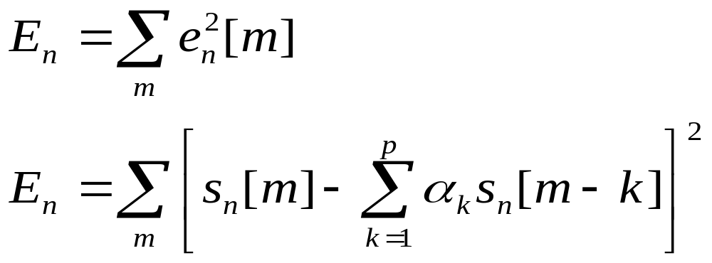
Solution for {α_{k}}
mean squared error signal:

Slide 11
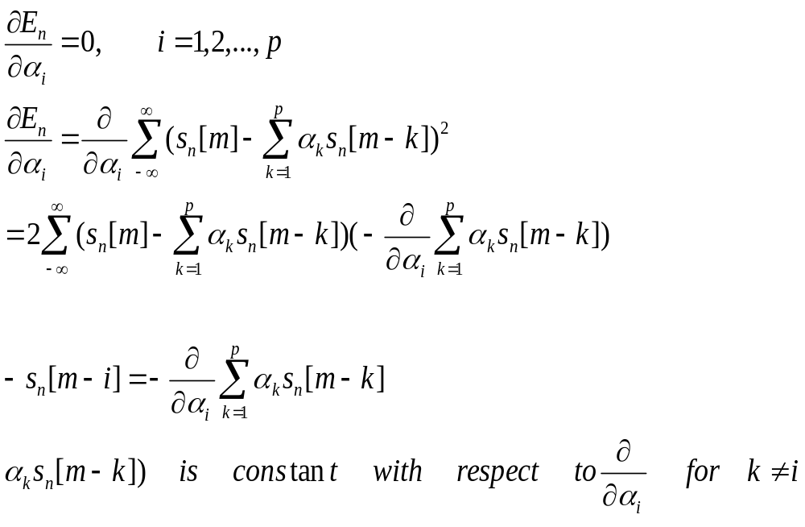
Can find values of α_{k} that minimize by setting
Where

Slide 12
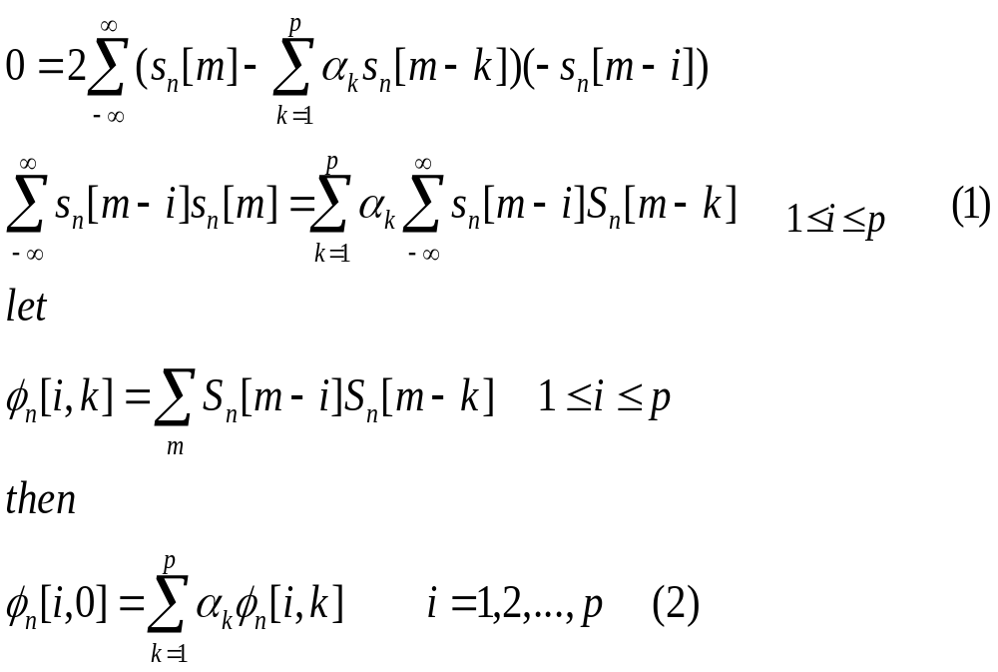
leading to a set of p equations in p unknowns that can solved in an efficient manner for the {α_{k}}

Slide 13
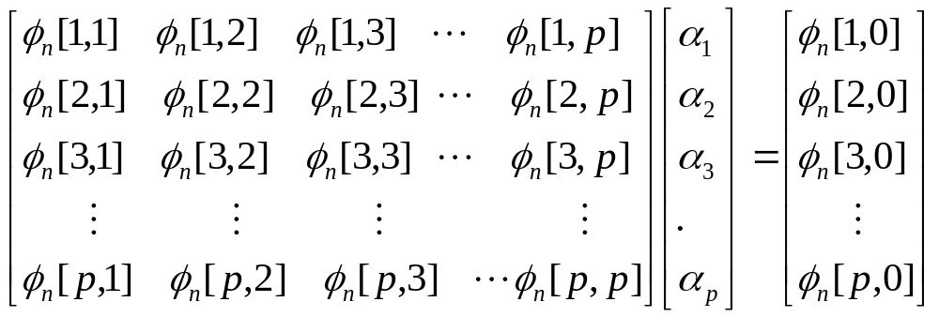
The resulting covariance matrix is symmetric, but not Toeplitz, and can be solved efficiently by a set of techniques called Cholesky decomposition

Slide 14
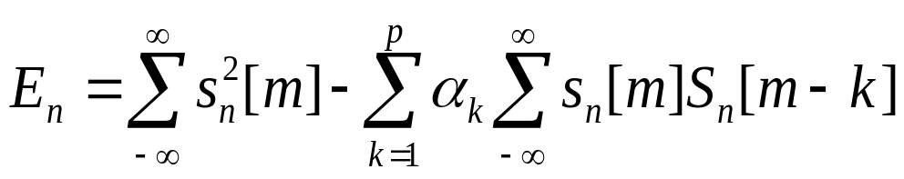
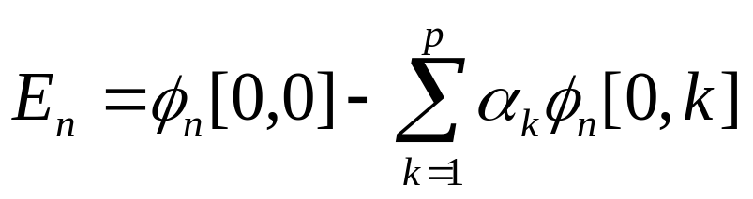
Minimum mean-squared prediction error can be written as

Slide 15
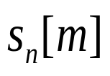
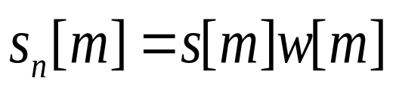
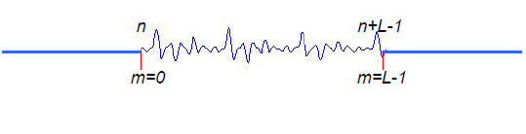
Autocorrelation Method
Let exists for 0 ≤ m ≤ L −1 and is exactly zero every where else (i.e., window of length samples)
Where w[m] is a finite length window of L samples

Slide 16
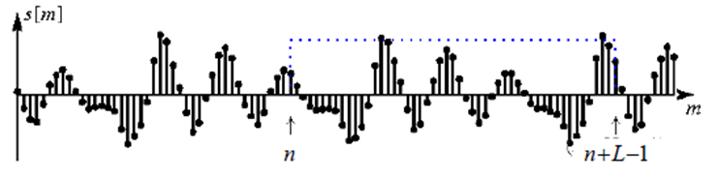
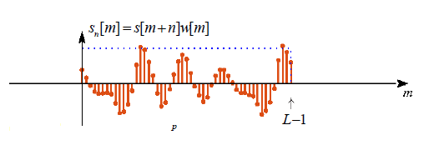
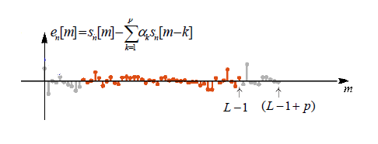

Slide 17
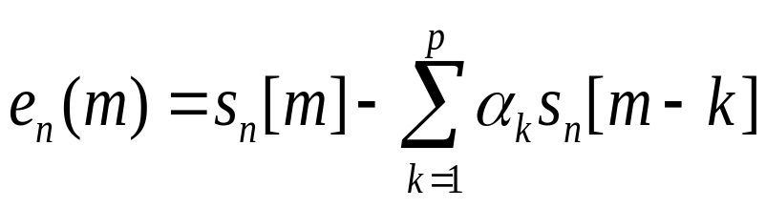

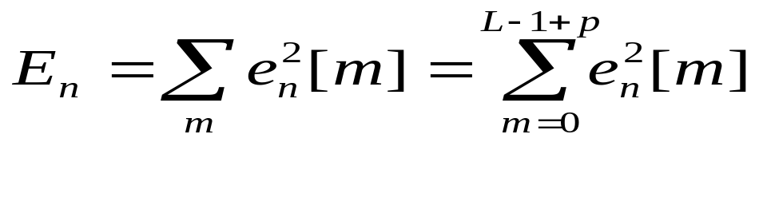
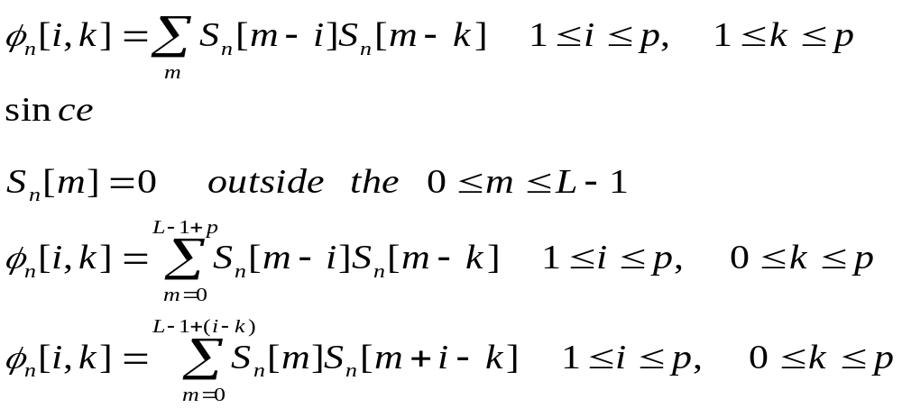
Is only non zero over the interval

Slide 18
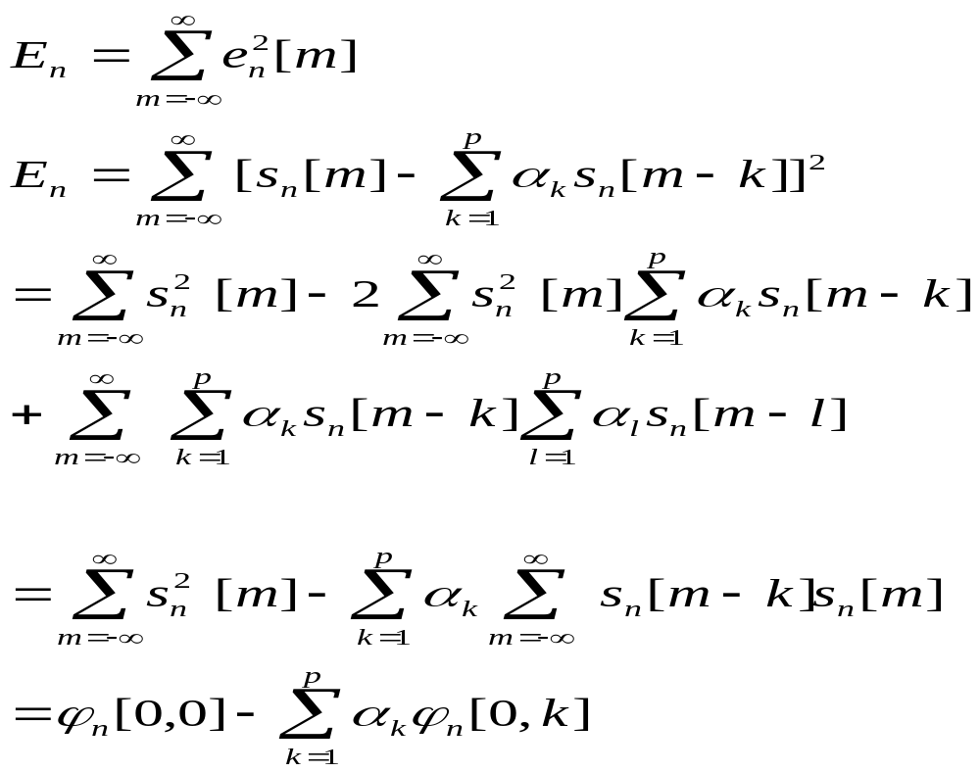

Slide 19
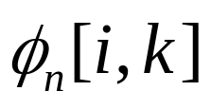
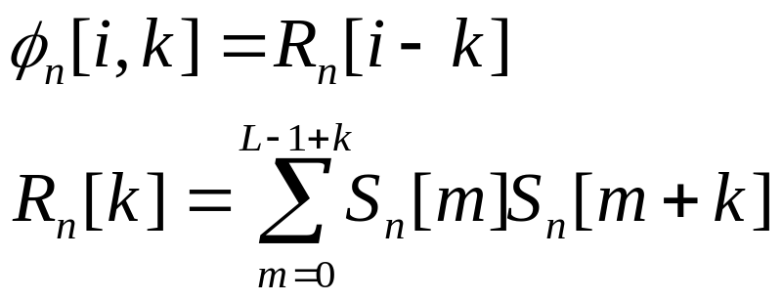
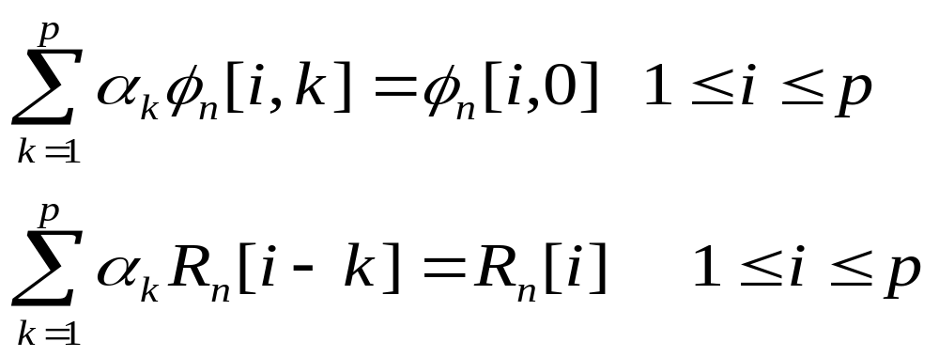
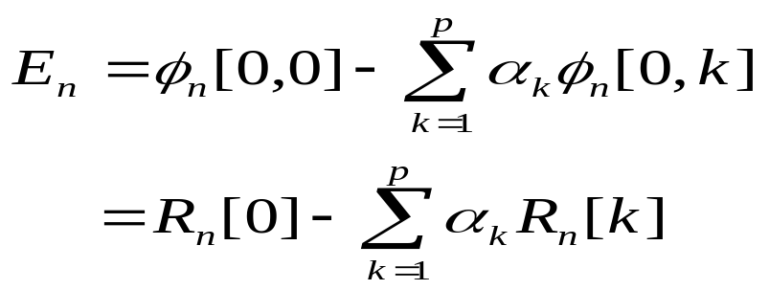
There are L-| i-k| non-zero terms in the computation of for each value of i,k
Then
short-time autocorrelation
From equation (2)
Minimum mean-squared prediction error can be written as

Slide 20
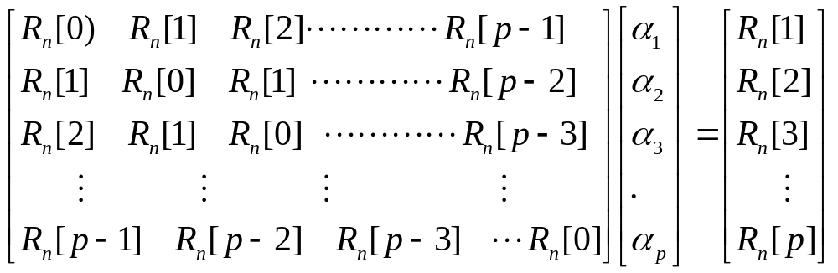
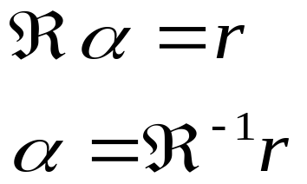
is a pxp Toeplitz Matrix => symmetric with all diagonal elements equal
matrix equation solved using Levinson or Durbin method

Slide 21
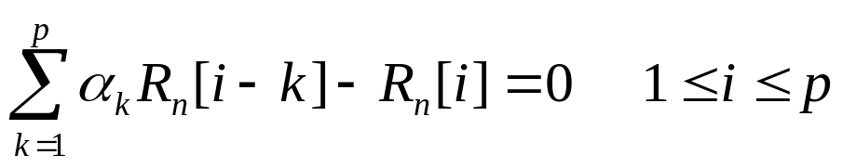
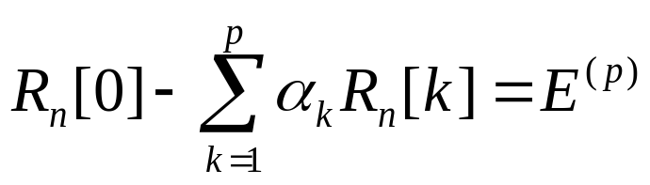
The set of optimum predictor coefficients satisfy
with minimum mean-squared prediction error of

Slide 22
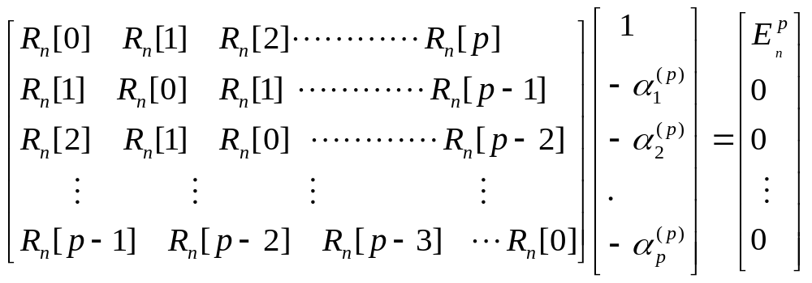


Expanded matrix is still Toeplitz and It can be solved iteratively by incorporating new correlation value at each iteration and solving for next higher order predictor in terms of new correlation value and previous predictor
i^{th} order solution can be derived from (i-1)^{st} order solution
given α^{(i-1)}, the solution to
we derive solution to

Slide 23
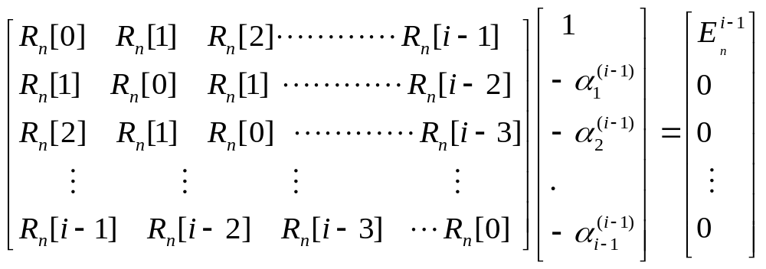
The (i −1)^{st} solution can be expressed as:

Slide 24
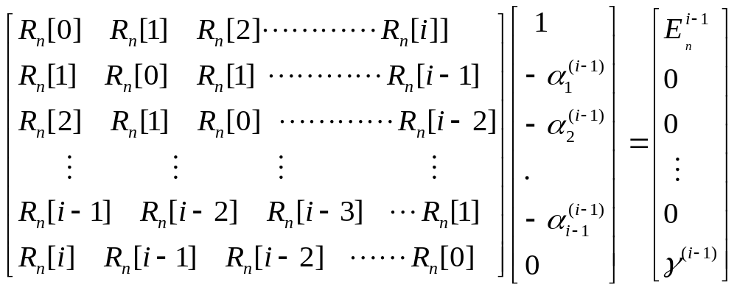
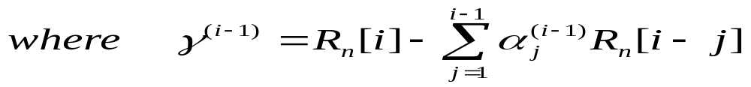
Appending a 0 to vector α and multiplying by the matrix R_{n}^{(i)} gives

Slide 25
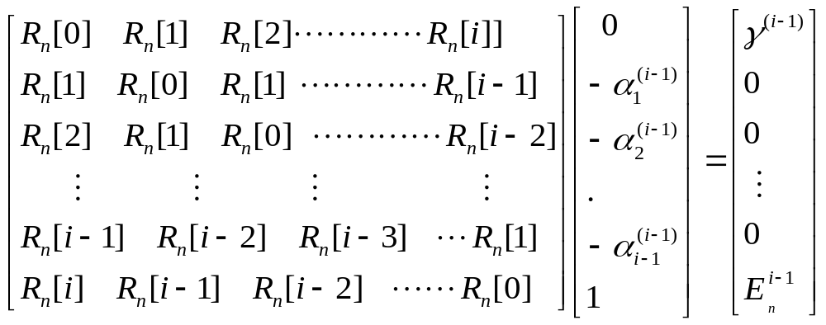
Toeplitz matrix has special symmetry we can reverse the order of the equations

Slide 26


Combine the two sets of matrices with a multiplicative factor k_{i}
Choose of γ^{(i-1)} so that vector on right has only a single non-zero entry, i.e
1

Slide 27

The first element of the right hand side vector is now
2
The k_{i} parameters are called Partial Correlation (PARCOR) coefficients
So the vector of order i^{th} predictor coefficients is

Slide 28





3
4
A. The final solution for order p is:
B. with prediction error
C. If we use normalized autocorrelation coefficients:
D. normalized prediction error

Slide 29


Slide 30
1. Consider a simple p = 2 find the solution
2. Consider a simple p = 3 find the solution
3. Consider a simple p = 4 find the solution

Slide 31

Prediction Error vs. Model Order
Model order is usually determined by:
  Fs/1000 poles for vocal tract
  2-4 poles for radiation
  2 poles for glottal pulse

Slide 32
End

Slide 33


Computation of Model Gain
1
Put m=0 in equation (1)

Slide 34

Energy in h[m]=Energy in short time measurement s_{n}[m]
Solution for Gain (Voiced)

Slide 35

Solution for Gain (Unvoiced)
For unvoiced speech the input is white noise with zero mean and unity variance,
Excite the system with input Au[n]

Slide 36


Slide 37

Frequency Domain Interpretations of Linear Predictive Analysis
The final LPC model consists of the LPC parameters,α_{k} and gain A together which define the system function

Slide 38


Slide 39


Slide 40


Slide 41

Effects of Model Order
The AC R_{n}[m] function of the speech segment S_{n}[m], and the AC function Rˆ_{n}[m], of the impulse response, corresponding to the system function h_{n}[m], are equal for the first ( p +1) values. As p->α the AC functions are equal for all values and thus:

Slide 42


Slide 43


Linear Prediction Spectrogram
Speech spectrogram
LPC spectrogram

Slide 44


Slide 45



x
x
x
x
r
θ
x
o
-θ
x
x
x
x
x

Slide 46


Angle corresponds to frequency, and radius corresponds to bandwidth. So we can determine the pole (or resonant) frequencies and bandwidths (converting to Hz)

Slide 47
Lecture-16
Covariance Method for Linear Prediction

Slide 48
Can find values of α_{k} that minimize by setting
Where

Slide 49
leading to a set of p equations in p unknowns that can solved in an efficient manner for the {α_{k}}

Slide 50


Minimum mean-squared prediction error

Slide 51


Changing the summation index gives
key difference from Autocorrelation Method is that limits of summation include terms before m =0. i.e window extends p samples backwards
since we are extending window backwards, don't need to taper it using window function since there is no transition at window edges

Slide 52



1
2

Slide 53

the solution of the matrix equation is called the Cholesky decomposition, or square root method
φ Matrix is symmetric but not diagonal elements are same
Where A = lower triangular matrix with 1's on the main diagonal; D=diagonal matrix
determine elements of A and D by solving for ( i, j ) elements of the matrix equation

Slide 54


Let p=4 and matrix element

Slide 55









Solve matrix
Else
iterate procedure to solve for
d₁=φ₁₁
for(i=1; i<=p;i++)
{
}
for(j=2; j<p; j++)
{
for(i=j+1; i<=p; i++)
{
}
}

Slide 56





Y₁=ψ₁
for(i=1; i<=p; i++)
{
}

Slide 57




α_{p}=Y_{p}/d_{p}
for(i=1; i<=p; i++)
{
}
Calculation proceeds backwards from i=p-1 to 1

Slide 58
Lattice Formulations of Linear Prediction

Slide 59
Both covariance and autocorrelation methods of LP use two step solutions
  Step-1: computation of a matrix of correlation values
  Step-2: efficient solution of a set of linear equations
In lattice methods, two steps are combined into a recursive algorithm for determining LP parameters
It begin with Durbin algorithm--at the i^{th} stage the set of coefficients are coefficients of the i^{th} order optimum LP

Slide 60







i^{th} order prediction error filter
Forward prediction error

Slide 61


Slide 62




Levinson Recursion
Step-1
Step-2
Weighting factor of i^{th} pole model
Step-3
Step-4
Update the mean square prediction error

Slide 63






Slide 64





Slide 65















Equation No –(1)
Equation No –(2)
No prediction
Equation No –(3)
Lattice Filter for

Slide 66













All-Pole Lattice Filter for H(z)

Slide 67


Slide 68


Direct Computation of k Parameters
Minimize forward prediction error as

Slide 69


Minimize backward prediction error as

Slide 70



Slide 71


Slide 72


Slide 73


